Slide 1
Apartment management System
Presented by
M Sai Krishna (16K81A05E4)
Goparaju Sai Annapurna (16K81A05C9)
Thirunagari Sulakshana (16K81A05H1)
Bandari Pranitha (16K81A05C3)

Slide 2
Introduction
Apartment management system is coming up with the concept to replace the paperwork and to maintain all the information digitally. The owners/tenants and technicians can be notified about complaints. This application will be used by apartment president and owners/tenants.
This website is used to manage all the maintenance issues in an apartment digitally. It keeps track of status of complaint, technicians, notice board, suggestions etc. There are three modules in this website namely Administrator, Technician, User (Owner/tenant).. Everyone can access the notice board and also provide suggestions.
We have automatic notification feature using which the technician can get notify about the problem as soon as the admin approves a complaint. Using this website. we can minimize the human efforts and cost. It is very easy to use this website the user do not need any knowledge of latest technology to use it.

Slide 3
Existing System
In every apartment it is difficult task to use manage all the complaints .
Paper based approach is really difficult to maintain
Sometimes it may lead to mismatch of the complaints raised by the owner/tenants.
Unnecessary complaints can be approved because of lack of approval.
It is difficult to find the number of complaints raised by a particular owner/tenants.
It is very time taking process to note and resolve an issue
All this problems lead to the raise of an alternative option.

Slide 4
Proposed System
For managing all the complaints we are proposing a web application to take care of all the problems discussed before.
Implementations of this application will help users in several ways
A detailed approach can be provided for users to ease the process.
A computer based system can provide more accurate and organized method of document management over the long term.
The various modules of the application:

Slide 5



Project analysis slide 2
Module Analysis
Administrator
Technician
AMS
Owner/Tenants

Slide 6
Hardware and Software Specifications
HARDWARE SPECIFICATIONS:
CPU : Intel (R) Core
RAM : Minimum of 512MB or more.
Hard Disk : PC with 20GB.
SOFTWARE SPECIFICATIONS:
Operating System : Windows XP or Higher, Ubuntu, MacOS.
Web Browser : Google Chrome, IE8 or higher, Mozilla Firefox, safari
Technology : PHP, XAMPP with Apache Tomcat
Front End : PHP, CSS, JavaScript
Back End : SQL Server
PHP version : 7.0
IDE : ATOM
Frontend : HTML, CSS, JavaScript
Email Notification: : PHP-Mailer library

Slide 7
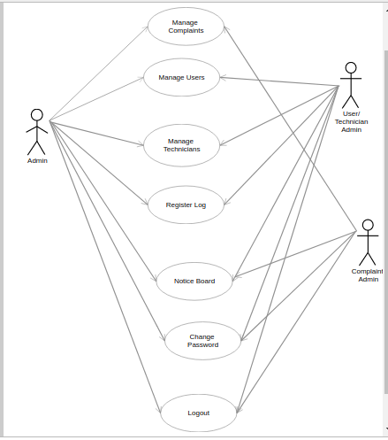
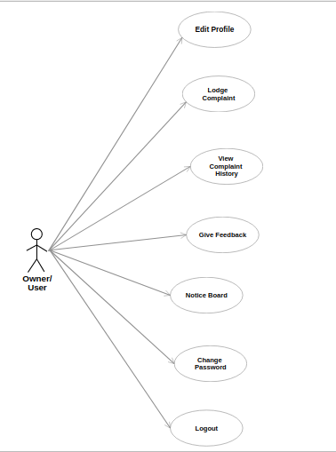
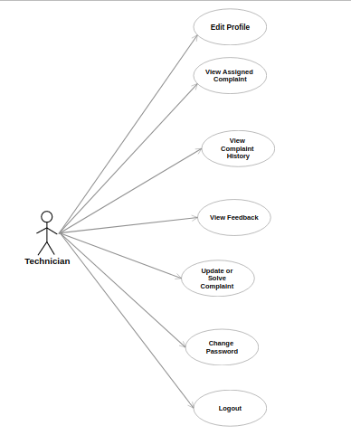
IMPLEMENTATION DETAILS USE CASE DIAGRAM ADMIN Owner(User) Technician

Slide 8
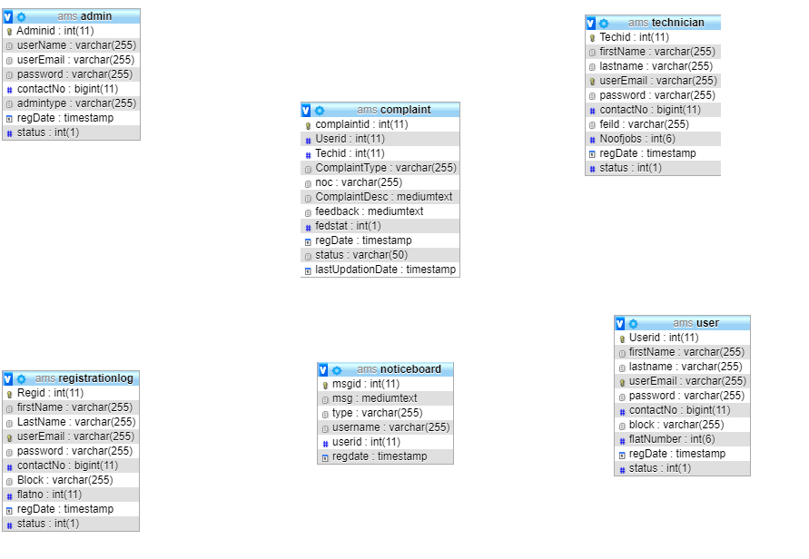
Class Diagram

Slide 9
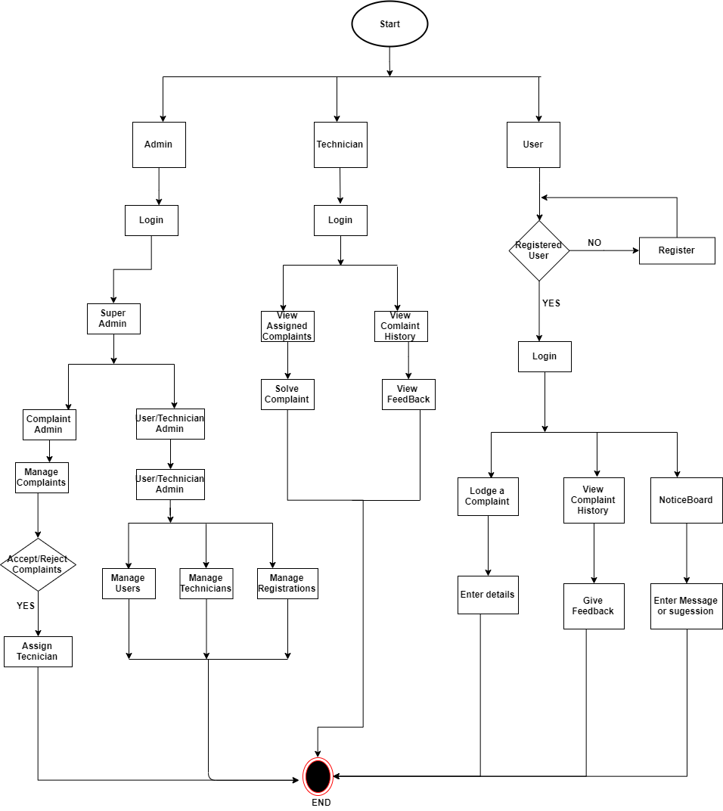
Flow Diagram

Slide 10
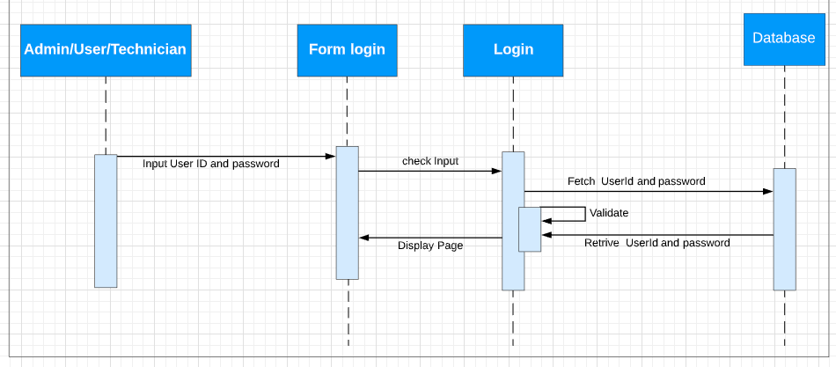
SEQUENCE DIAGRAMS
LOGIN

Slide 11
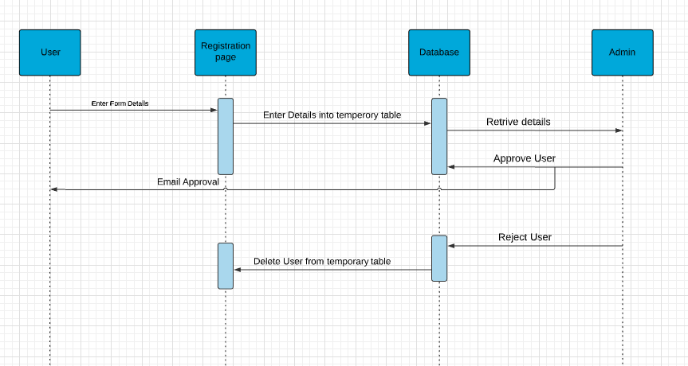
User Registration

Slide 12
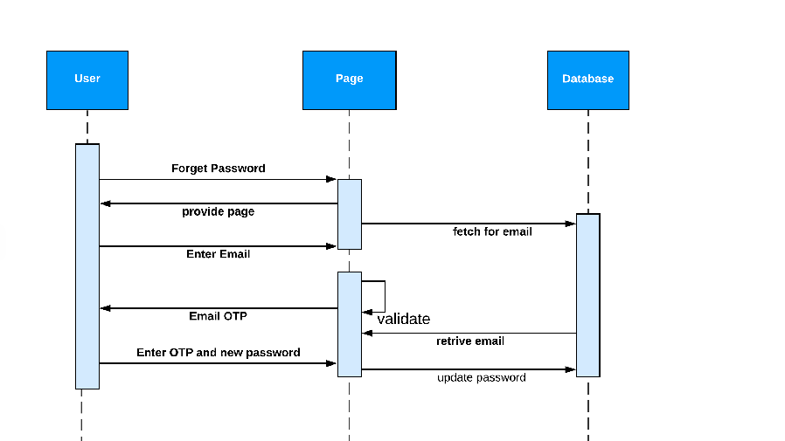
Forget Password

Slide 13
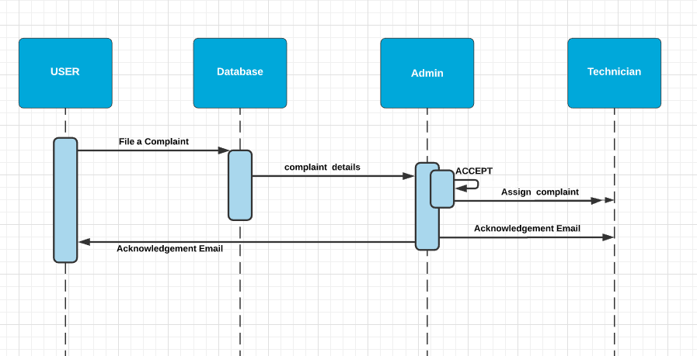
Lodging a complaint

Slide 14
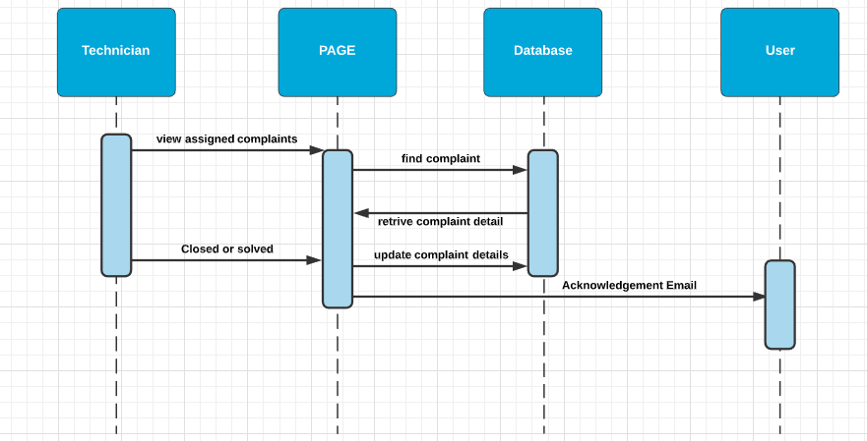
Close a Complaint

Slide 15
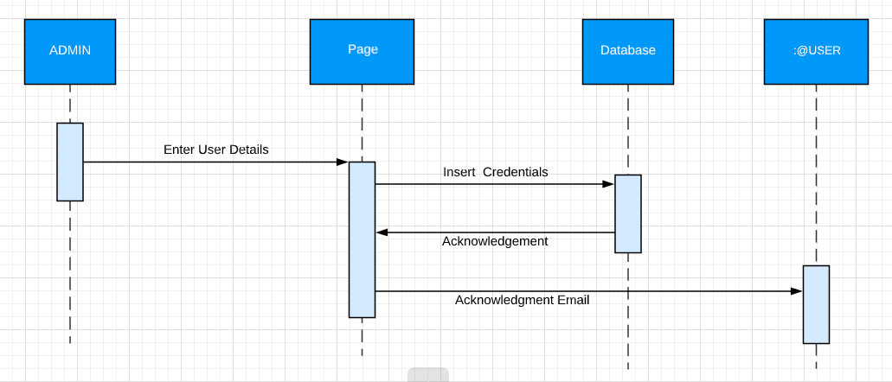
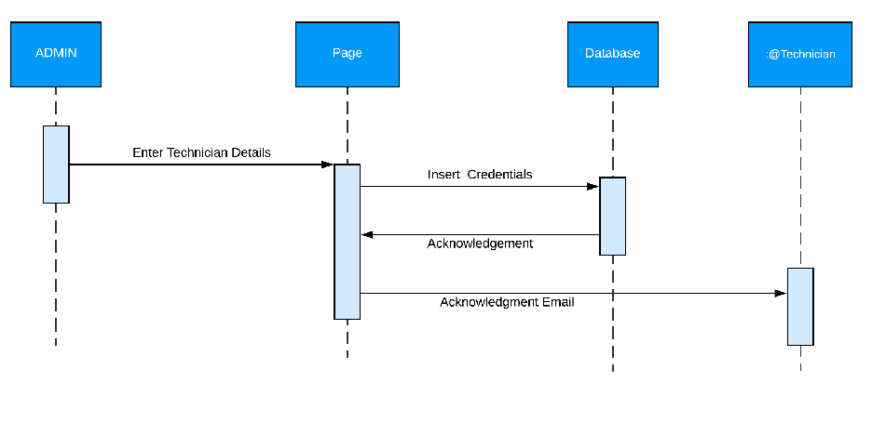
Admin Adding User/Technician

Slide 16
WORKING
This system is a Multi module Website of PHP. It has three main components the Admin page, User Page, Technician Page
Administrator Module(President)
This Page contains full access to Admin where he can control the flow of complaints. On page load after successful login the system welcomes Admin with Dashboard with basic statistics like No of complaints, No of Users, No of Technicians. No of Registrations etc.
Admin has whole bunch of options where he can manage Complaints, Users, Technicians.
To reduce the work load of the Admin we come up with multiple admins with different access roles. There are basically three types of Admins. They are
Super Admin.
Complaint Admin.
User/Technician Admin.
Based on login credentials Admin are distinguished. Super admin can avail all access privileges. Where as Complaint Admin and User/Technician Admin are restricted to certain options. Super Admin can Avail all features of both Complaint and User/Technician Admin.

Slide 17
User/Technician Admin:
In this module this type of admin can only Manage Users and Technicians. This Admin is responsible for Technician and user management. He can Add Users , Technicians and Accept Registrations from New Users. He can also Access Notice Board.
Admin can either accept or delete a registered user who registered through website Once accepted user can avail his services. User will also receive Acknowledge email of acceptance. Admin can also manage technicians. When a technician leaves the apartment, his account has to be closed. Admin can easily delete the technician whenever required. Similarly, admin can also Manage and delete users of the Apartment.
When Admin Adds either User or technician, they will be notified via an email along with their credentials.
Admin can view User details alongside can take action on and assign a complaint to technician. We can also assign technician to a complaint based on No of tasks technician already dealing with. Admin can also reject the complaint based on availability of service. Admin can view closed and pending complaint details.

Slide 18
Complaint Admin:
In this module Admin can only Manage Complaints. In This module Admin can see Complaints based on three flags they are ‘Not Processed’, ’Pending’, ’Closed’. Not Processed are the complaints which are just filed by users but not accepted by Admin. Here Admin can view Complaint details and take action like Assigning a Technician, or Rejecting a Complaint. Admin can also Reject a complaint even if it is approved but not closed.
Complaints which are solved comes under Closed complaints. Admin can also view complete details of user who filed a complaint but cannot manipulate the user or technician. When admin assigns a technician to Complaint. Both Technician and User will receive Email notification regarding the details of Complaint details and individual details. Admin can view a list of complaints which are filed by users but no necessary action is taken.
Admin can view User details alongside can take action on and assign a complaint to technician. We can also assign technician to a complaint based on No of tasks technician already dealing with. Admin can also reject the complaint based on availability of service. Admin can view closed and pending complaint details.

Slide 19
2. Owner/Tenant Module(user)
Login.
User Registration.
View/ Update Profile Details.
Open a Complaint.
Track a Complaint.
View Notice Board.
Email Notification of complaint registration..
View Complaint Log.
Feedback of complaint.
Change Password.
Forget Password.

Slide 20
Login:
Owner /tenants are the key users of this website or web application. Owners login into their account and start accessing their services. User passwords are safely encrypted using MD5 algorithm over the network and also stored as encrypted password in local database. So there is a high security to their accounts.
Open a Complaint:
User can lodge a complaint from simply clicking on lodge complaint from side bar and filling complaint details with description and type of complaint i.e., choosing type of service and submit the form later it is processed by admin so that technician can solve that complaint.
Track a Complaint:
User can check their complaint history, can view their complaint status i.e., track complaint status. If complaint is closed user can give feedback to the technician.
Feedback of complaint:
When a complaint is solved user can give feedback to technician. So that technician can improve further in quality of service.
User Registration:
To access the services one can register through website by filling the details and submitting the form. Users has to wait till the admin approves. Once they are approved user gets notified through Email and can start availing the services.
Forget Password:
When a user forget his/ her password we can retrive account by sending an OTP (one-time-password) to registered Email. After Verifying Email User can create new password and recover account. If there is no user present system generates error message.

Slide 21
3. Technician Module
Login
View/update Profile Details
Can Check Assigned Complaints
Notified by Email When Task is Assigned
Receive feedback
Change password
Forget Password.

Slide 22
Login:
Technician is a person who resolves the complaints raised by the users. Technician login into their account and start solving their assigned comlpaints. So the interface for technician should be very minimalistic. Technician passwords are safely encrypted using MD5 algorithm over the network and also stored as encrypted password in local database. So there is a high security to their accounts.
View/update Profile Details:
Technician can view or edit his profile .But cannot edit default values like Technician ID, Email ID type of job . Technician can edit his account details any no of times
Assigned Complaints:
Technician can view Complaints Assigned to him and user contact details who filed a complaint. User can view complete description and user details. After a complaint is solved technician can close a complaint and acknowledgement mail is sent to the concerned user.
Receive feedback:
When a complaint is solved user can give feedback to technician. So that technician can improve further in quality of service.
Forget Password:
When a user forget his/ her password we can retrive account by sending an OTP (one-time-password) to registered Email. After Verifying Email User can create new password and recover account. If there is no user present system generates error message.

Slide 23
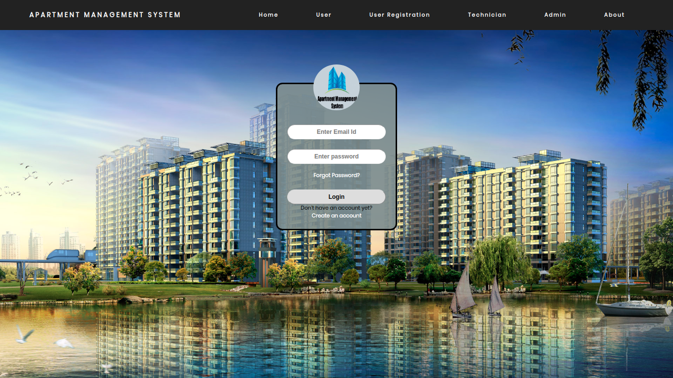
LOGIN FORM FOR USER

Slide 24
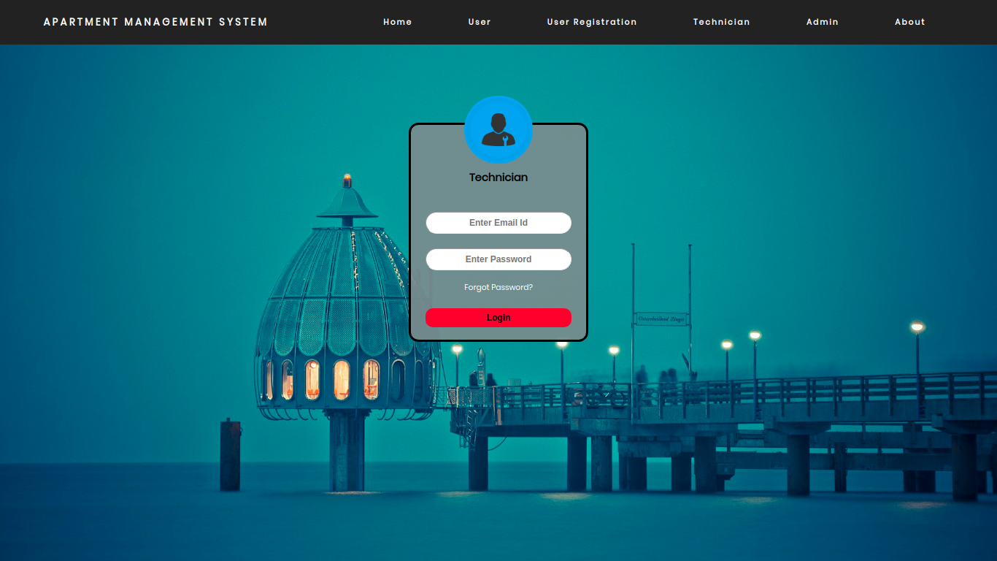
LOGIN FOR TECHNICIAN

Slide 25
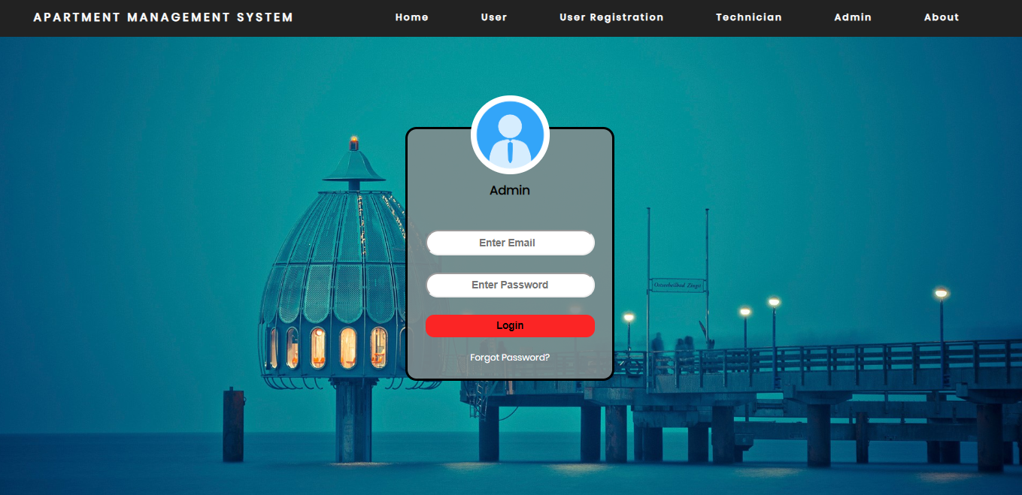
LOGIN FORM FOR ADMIN

Slide 26
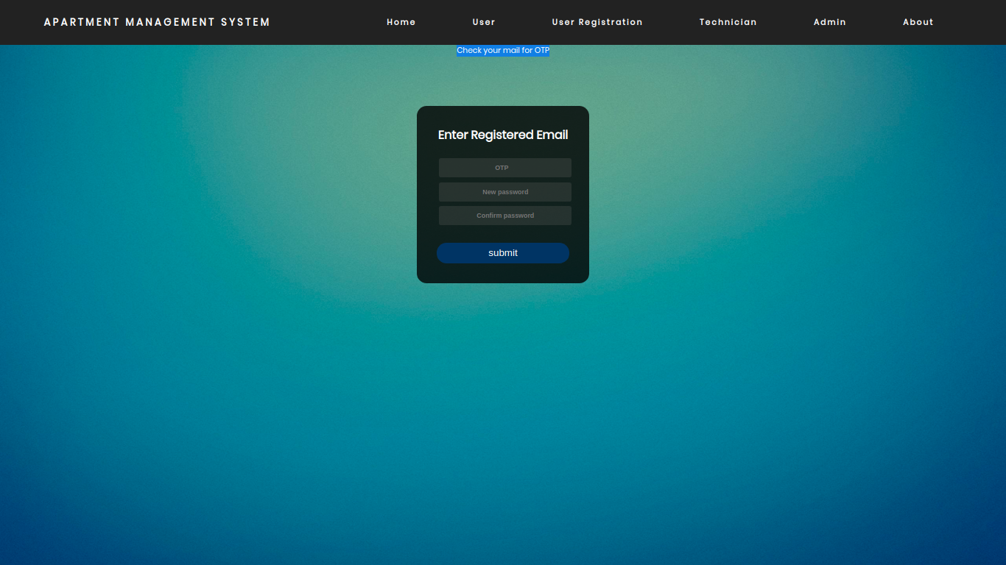
FORGET PASSORD

Slide 27
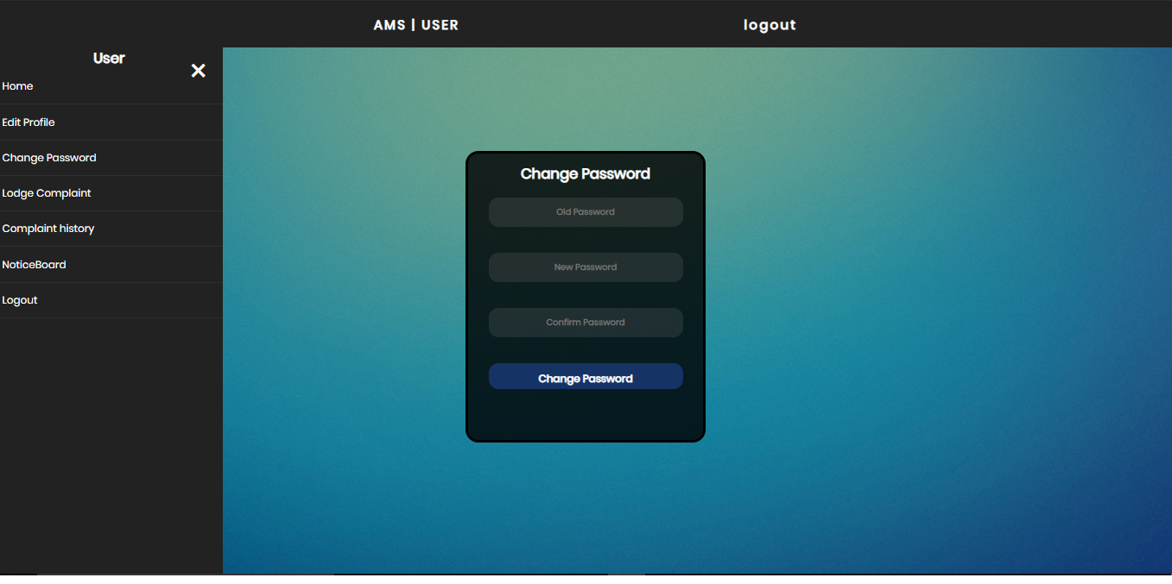
CHANGE PASSWORD

Slide 28
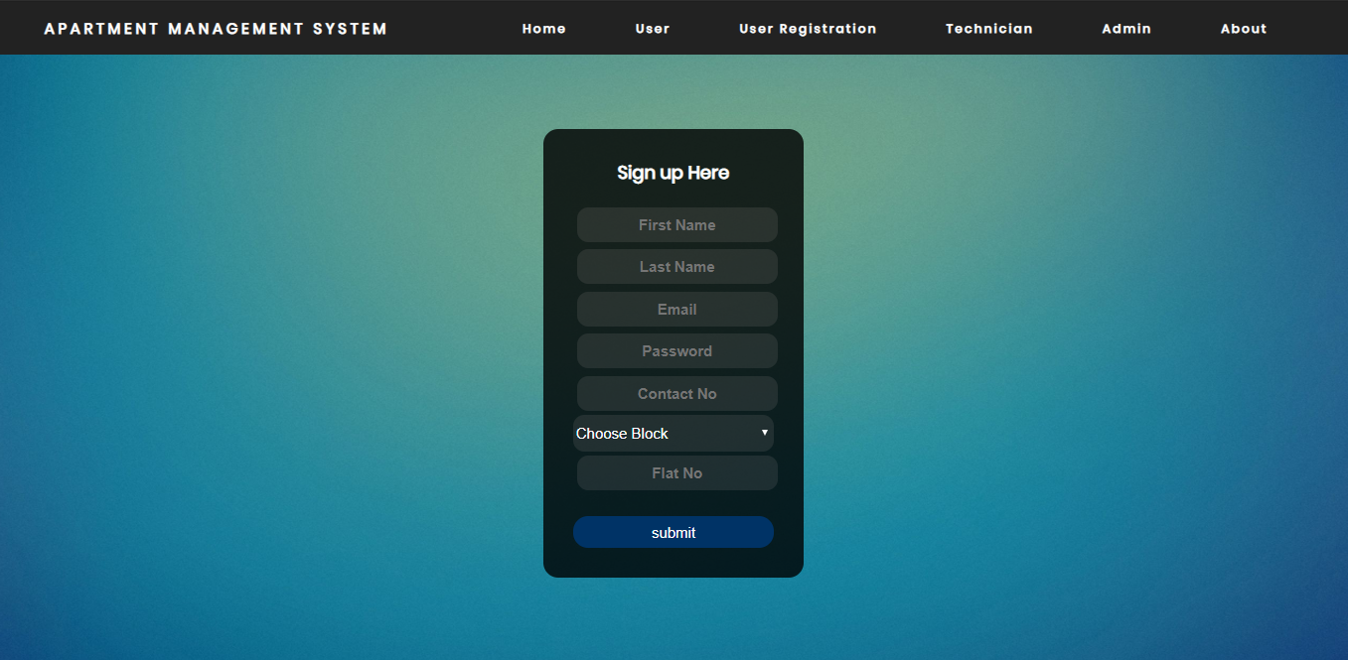
User Registration

Slide 29
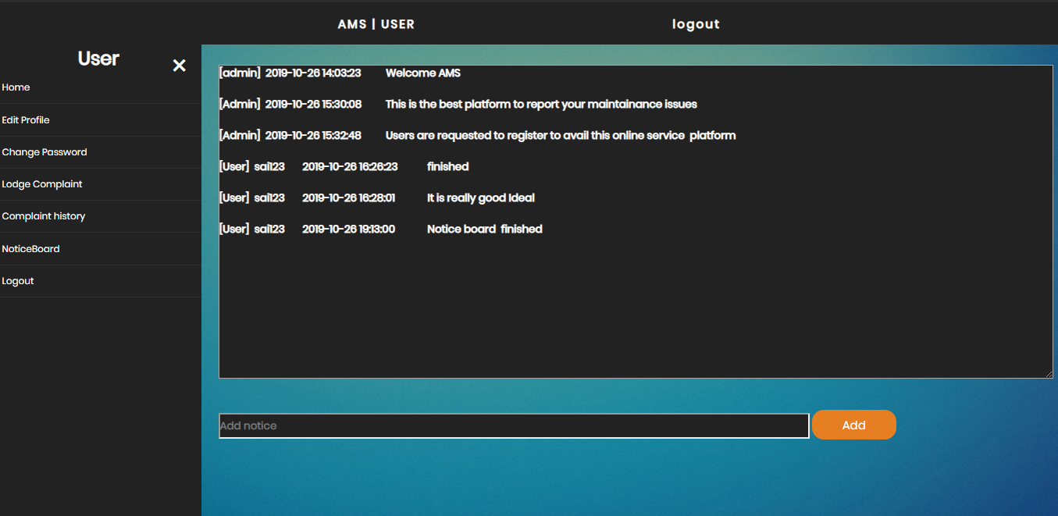
Notice Board

Slide 30
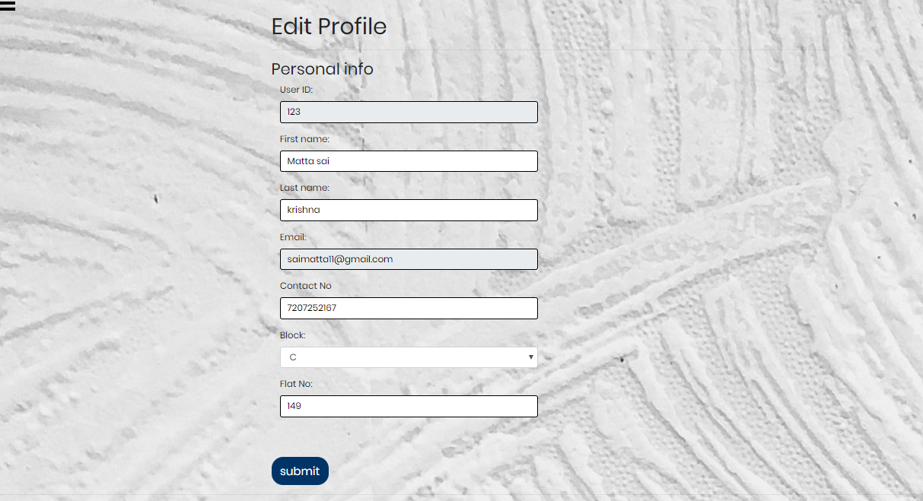
View or Edit Profile

Slide 31
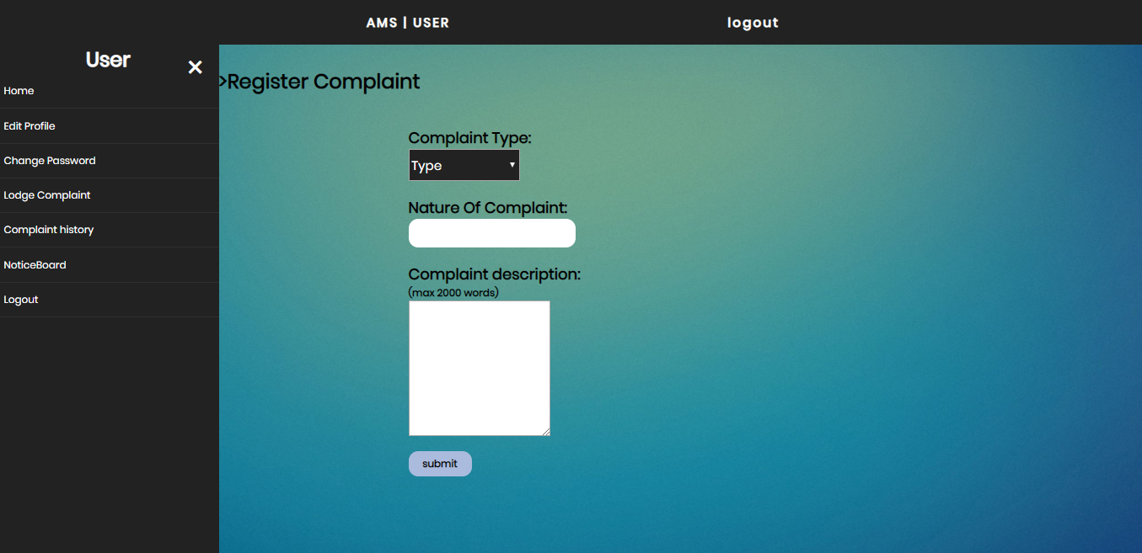
Register Complaint

Slide 32
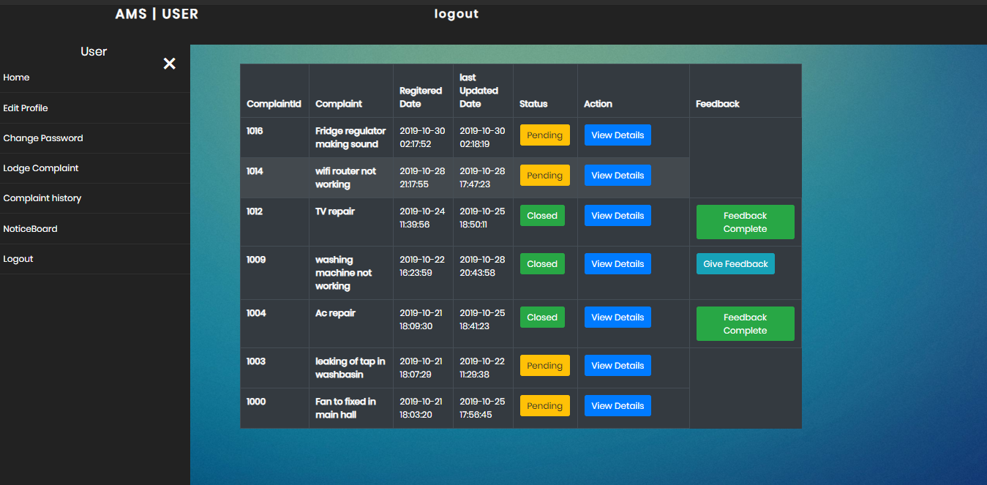
User Complaint History

Slide 33
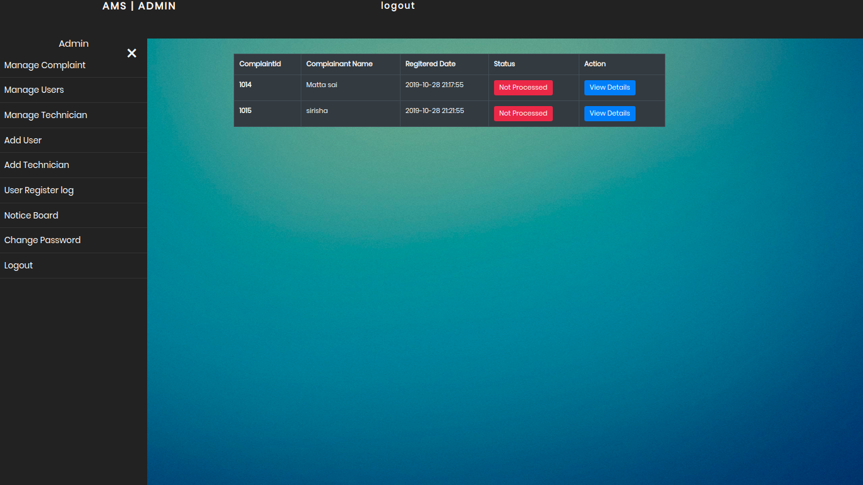
Admin View Complaints

Slide 34
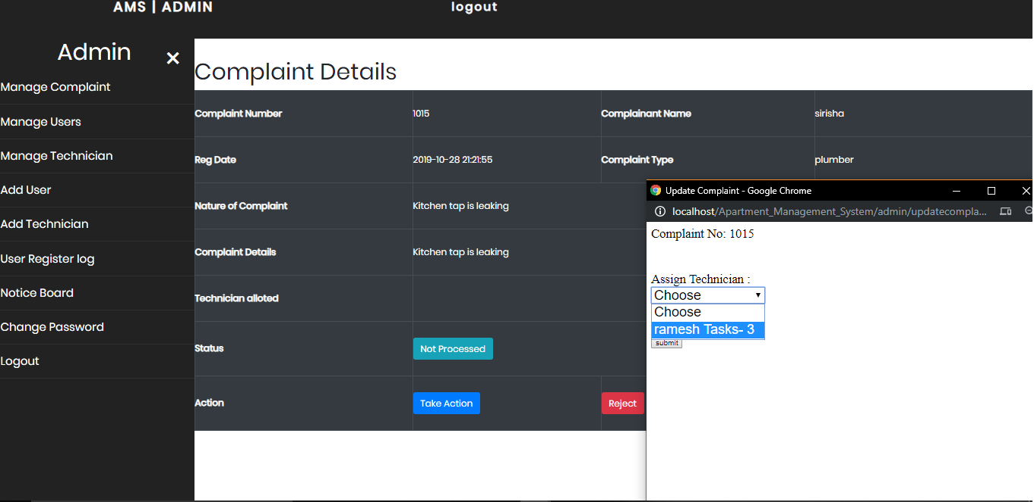
Assign Technician

Slide 35
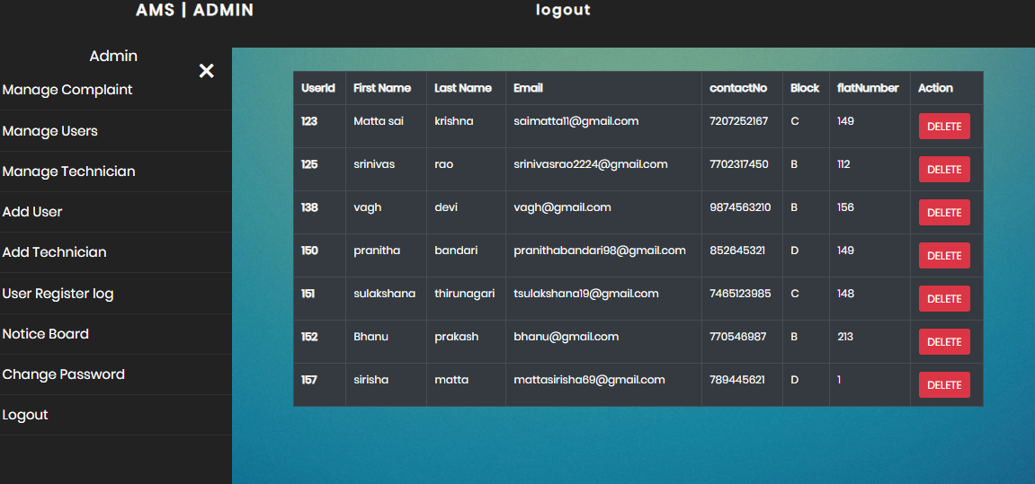
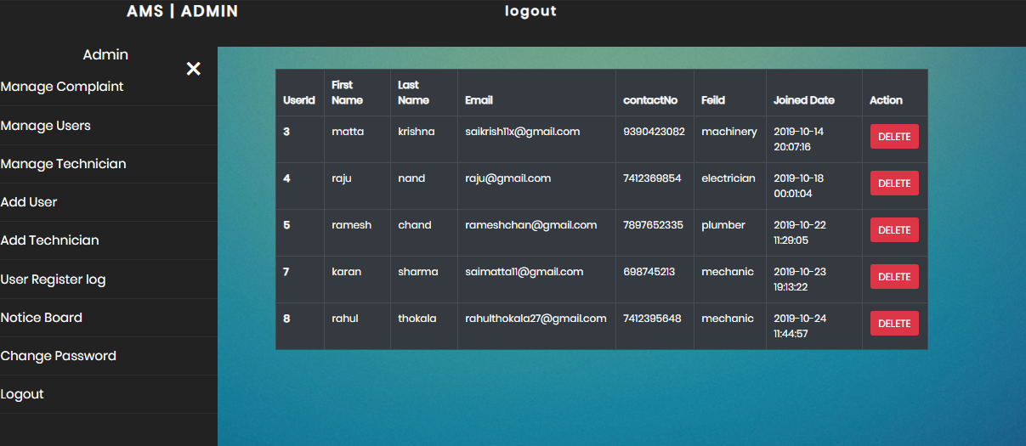
Admin Manages existing users/Technicians

Slide 36
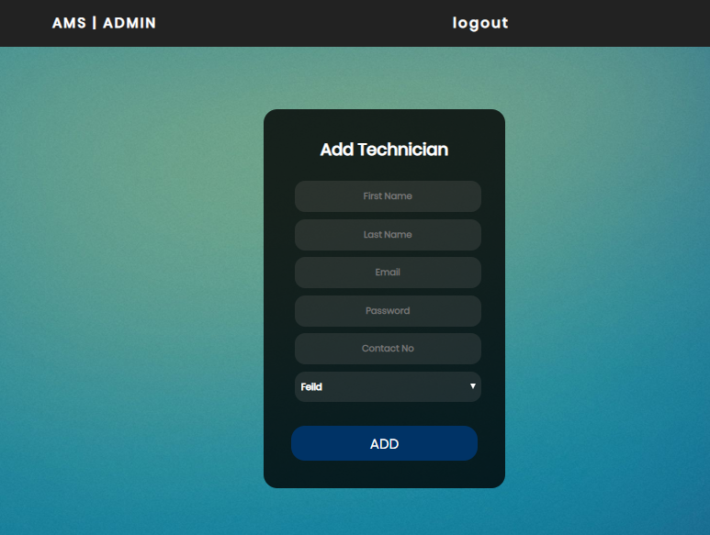
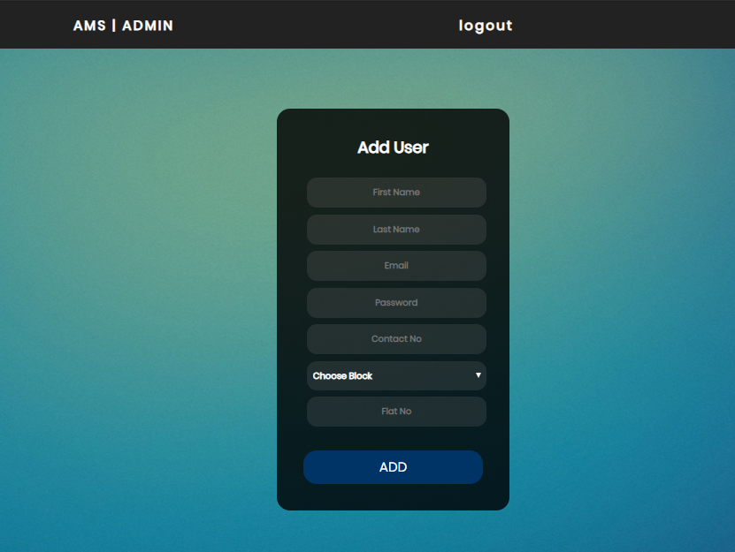
Admin Adding users/Technicians

Slide 37
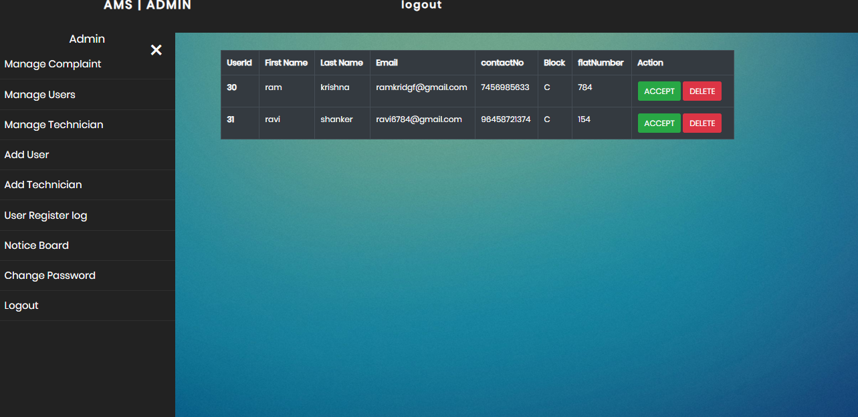
Admin User register log

Slide 38
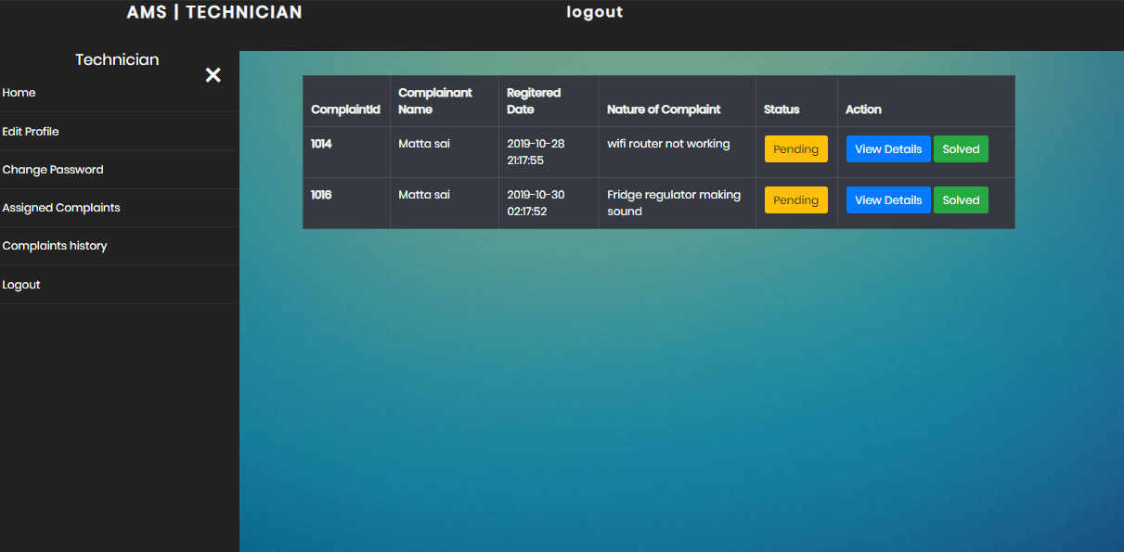
Technician Assigned Complaints

Slide 39
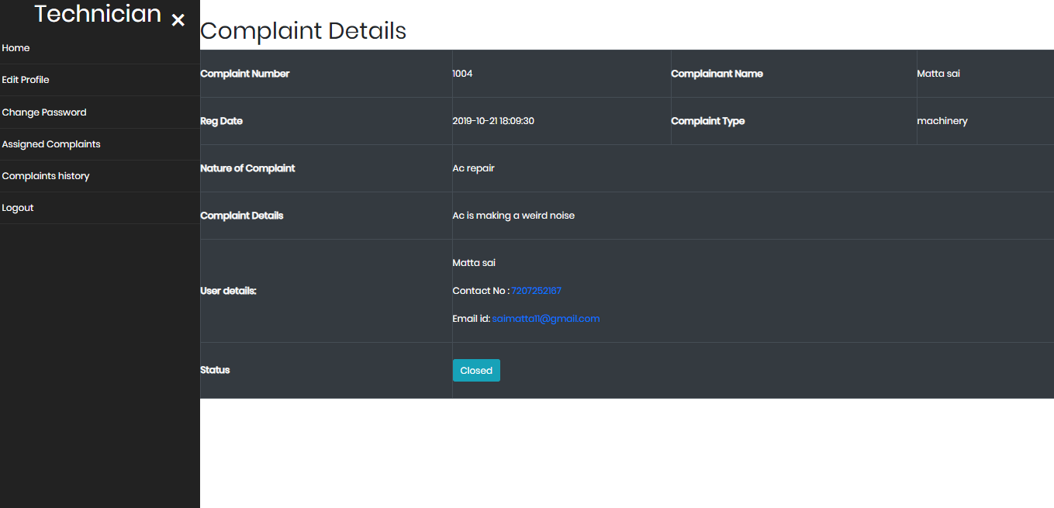
Technician View Complaint Details

Slide 40
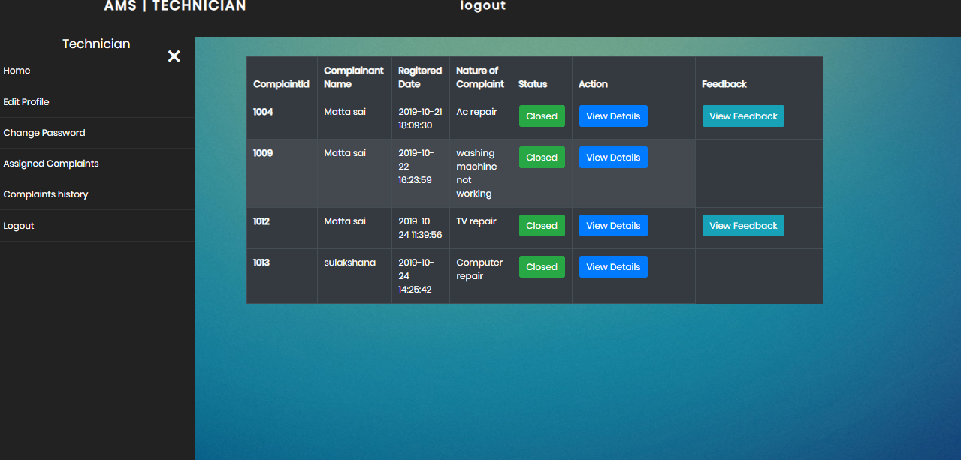
Technician Complaint History

Slide 41
TESTING
UNIT TESTING
Unit testing was done on each and every module that is described
Test for the admin module :
Testing admin login form.
Approve complaints
Assign complaints
Add/Remove Users/Technicians.
Notice Board
Test for the User module :
Lodge complaint
Give feedback
Notice Board
Complaint history
Test for the Technician module :
View Assigned complaints
View Feedback and complaint history
Edit profile and change password.
INTEGRATION TESTING
In this type of testing we test various integration of the project module by providing the input .The primary objective is to test the module interfaces in order to ensure that no errors are occurring when one module invokes the other module.

Slide 42
CONCLUSIONS AND FUTURE SCOPE
In this paper we come up with the system to combine all the apartment maintenance related issues digitally to one place where a technician is assigned to solve the complaint raised by the user. This service provides hassle free experience to maintenance of apartment. This system aids to reduce obstacles such as manual entry of complaints, high waiting time with Faster notifications through email. This system will direct the user about the menu and the required operation to be performed and the result of the operation. Taking into account all these implementation techniques this system becomes user friendly and interactive cost effective and feature rich. The system has the benefits of easy access because it is be developed as a platform independent web application, so the admin can maintain a proper contact with their owners/tenants and technicians, which can be accessed anywhere. All communications between the owner/tenants and administrator or administrator and technician has done through the online, so the communication cost can also be reduced.
The system that we have developed can be accessed by anyone on the web using Internet. The system proposed supports only emails system which can be further integrated with SMS. The System which is currently present in English Only. So Uneducated Technicians might face difficulty. There is a scope of implementing this system which supports multiple languages. Mobile based android or ios application can be implemented using this system.

Slide 43



Project analysis slide 3
Overview
Minimizing human effort and cost efficient database
Fast Processing and immediate results
Ease of Use
Notice Board
Automatic
Notifications
Both Owners/Tenants and Technicians can receive automatic emails when a complaint is registered
Owners/tenants and technicians can quickly receive instructions and
Mainly focusing on
Resolving an issue
There is no physical maintenance of record books, so human efforts are reduced
It is a very easy application to use. User Donot require Additional Technical knowledge to use it
Everyone can access
Noticeboard to announce events and also provide suggestions to share among users

Slide 44
REFERENCES
PHP- The Complete reference by Steven Holzner.
www.php.net(Official PHP Website).
www.getbootstrap.com(Bootstrap Official website).
Head First PHP & MySQL – by Lynn Beighley & Michael Morrison.
Learning PHP, MySQL, JavaScript, and CSS: A Step-by-Step Guide to Creating Dynamic Websites – by Robin Nixon
https://phpmailer.github.io/PHPMailer/classes/PHPMailer.PHPMailer.PHPMailer.html
www.w3schools.com

Slide 45
Thank You

